Slide 1
Church of God
Bible
Doctrine of Repentance

Slide 2
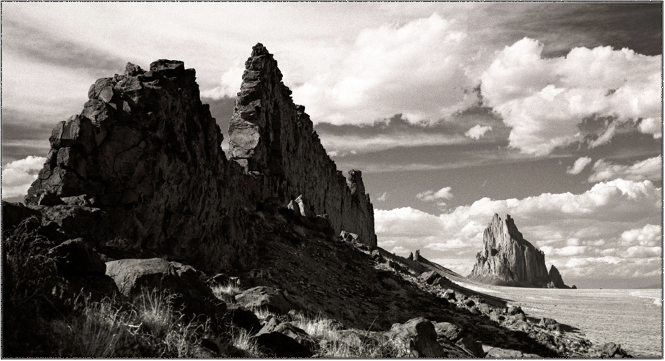
True Repentance

Slide 3
What is the definition of Repent?
RE'PENT, a. [L. repo, to creep.] Creeping; as a repent root.
REPENT', v.i. [L. re and paeniteo, from paena, pain. Gr. See Paint.]
1. To feel pain, sorrow or regret for something done or spoken; as, to repent that we have lost much time in idleness or sensual pleasure; to repent that we have injured or wounded the feelings of a friend. A person repents only of what he himself has done or said.
2. To express sorrow for something past.
Enobarbus did before thy face repent.
3. To change the mind in consequence of the inconvenience or injury done by past conduct.
Lest peradventure the people repent when they see war, and they return. Exo 13.
4. Applied to the Supreme Being, to change the course of providential dealings. Gen 6. Psa 106.
5. In theology, to sorrow or be pained for sin, as a violation of God's holy law, a dishonor to his character and government, and the foulest ingratitude to a Being of infinite benevolence.
Except ye repent, ye shall all likewise perish. Luke 13. Acts 3.
REPENT', v.t
1. To remember with sorrow; as, to repent rash words; to repent an injury done to a neighbor; to repent follies and vices. [See Repentance.]
2. With the reciprocal pronoun.
No man repented him of his wickedness. Jer 8.
[This form of expression is now obsolete.]

Slide 4
When Jesus began his ministry, he preached the doctrine of repentance.
Matthew 4:17 KJV
[17] From that time Jesus began to preach, and to say, Repent: for the kingdom of heaven is at hand.
John The Baptist required repentance of those who came to him to be baptized.
Luke 3:3 KJV
[3] And he came into all the country about Jordan, preaching the baptism of repentance for the remission of sins;
Luke 3:8 KJV
[8] Bring forth therefore fruits worthy of repentance, and begin not to say within yourselves, We have Abraham to our father: for I say unto you, That God is able of these stones to raise up children unto Abraham.

Slide 5
Isaiah defines repentance:
Isaiah 55:7 KJV
[7] Let the wicked forsake his way, and the unrighteous man his thoughts: and let him return unto the Lord , and he will have mercy upon him; and to our God, for he will abundantly pardon.
Jesus Commanded ALL men to REPENT.
Mark 1:15 KJV
[15] And saying, The time is fulfilled, and the kingdom of God is at hand: repent ye, and believe the gospel.

Slide 6
The Apostles commanded sinners to repent.
Acts 2:38 KJV
[38] Then Peter said unto them, Repent, and be baptized every one of you in the name of Jesus Christ for the remission of sins, and ye shall receive the gift of the Holy Ghost
Acts 3:19 KJV
[19] Repent ye therefore, and be converted, that your sins may be blotted out, when the times of refreshing shall come from the presence of the Lord;
Acts 17:30 KJV
[30] And the times of this ignorance God winked at; but now commandeth all men every where to repent:

Slide 7
Repentance is required of all no matter how good or
self- righteous one may be.
Luke 13:1-5 KJV
[1] There were present at that season some that told him of the Galilaeans, whose blood Pilate had mingled with their sacrifices. [2] And Jesus answering said unto them, Suppose ye that these Galilaeans were sinners above all the Galilaeans, because they suffered such things? [3] I tell you, Nay: but, except ye repent, ye shall all likewise perish. [4] Or those eighteen, upon whom the tower in Siloam fell, and slew them, think ye that they were sinners above all men that dwelt in Jerusalem? [5] I tell you, Nay: but, except ye repent, ye shall all likewise perish.

Slide 8
WHY?
Romans 3:23 KJV
[23] For all have sinned, and come short of the glory of God;

Slide 9
REPENTANCE IS TO HAVE TRUE GODLY SORROW.
Luke 18:10-14 KJV
[10] Two men went up into the temple to pray; the one a Pharisee, and the other a publican. [11] The Pharisee stood and prayed thus with himself, God, I thank thee, that I am not as other men are , extortioners, unjust, adulterers, or even as this publican. [12] I fast twice in the week, I give tithes of all that I possess. [13] And the publican, standing afar off, would not lift up so much as his eyes unto heaven, but smote upon his breast, saying, God be merciful to me a sinner. [14] I tell you, this man went down to his house justified rather than the other: for every one that exalteth himself shall be abased; and he that humbleth himself shall be exalted.

Slide 10
TRUE GODLY SORROW IS NOT THE SORROW OF THE WORLD.
2 Corinthians 7:8-11 KJV [8] For though I made you sorry with a letter, I do not relent, though I did repent: for I perceive that the same epistle hath made you sorry, though it were but for a season. [9] Now I rejoice, not that ye were made sorry, but that ye sorrowed to repentance: for ye were made sorry after a godly manner, that ye might receive damage by us in nothing. [10] For godly sorrow worketh repentance to salvation not to be repented of: but the sorrow of the world worketh death. [11] For behold this selfsame thing, that ye sorrowed after a godly sort, what carefulness it wrought in you, yea, what clearing of yourselves, yea, what indignation, yea, what fear, yea, what vehement desire, yea, what zeal, yea, what revenge! In all things ye have approved yourselves to be clear in this matter.

Slide 11
Psalm 51:17 KJV
[17] The sacrifices of God are a broken spirit: a broken and a contrite heart, O God, thou wilt not despise.
2) WHEN THE PRODIGAL SON RETURNED HOME, HE EXEMPLIFIED GODLY SORROW. Luke 15:21 KJV
[21] And the son said unto him, Father, I have sinned against heaven, and in thy sight, and am no more worthy to be called thy son.

Slide 12
The Spirit of God MUST first convict man of his sins before he can repent!
John 6:44 KJV
[44] No man can come to me, except the Father which hath sent me draw him: and I will raise him up at the last day.
John 16:8 KJV
[8] And when he is come, he will reprove the world of sin, and of righteousness, and of judgment:

Slide 13
Sins are confessed before God NOT men!
1 John 1:9 KJV
[9] If we confess our sins, he is faithful and just to forgive us our sins, and to cleanse us from all unrighteousness.
Sins must be confessed to God who alone has power to forgive sins.

Slide 14
CONFESSION OF WRONGS AND SEEKING FORGIVENESS MUST BE MADE TO MEN WHO HAVE BEEN WRONGED.

Slide 15
Matthew 5:23-24 KJV
[23] Therefore if thou bring thy gift to the altar, and there rememberest that thy brother hath ought against thee; [24] Leave there thy gift before the altar, and go thy way; first be reconciled to thy brother, and then come and offer thy gift.
This produces a good conscience toward men as well as toward God.
Acts 24:16 KJV
[16] And herein do I exercise myself, to have always a conscience void of offence toward God, and toward men.

Slide 16
REPENTANCE ALSO REQUIRES THAT RESTITUTION BE MADE.
Ezekiel 33:15 KJV
[15] If the wicked restore the pledge, give again that he had robbed, walk in the statutes of life, without committing iniquity; he shall surely live, he shall not die.
Restitution was one of the first things that Zacchaeus thought of after he met Jesus Christ.
Luke 19:8 KJV
[8] And Zacchaeus stood, and said unto the Lord; Behold, Lord, the half of my goods I give to the poor; and if I have taken any thing from any man by false accusation, I restore him fourfold.

Slide 17
REPENTANCE INCLUDES FORGIVING OTHERS.
All hatred, malice, grudges, ill-feelings toward others must be forsaken and those persons forgiven.
Matthew 6:14-15 KJV
[14] For if ye forgive men their trespasses, your heavenly Father will also forgive you: [15] But if ye forgive not men their trespasses, neither will your Father forgive your trespasses.
Jesus is our example.
Luke 23:34 KJV
[34] Then said Jesus, Father, forgive them; for they know not what they do. And they parted his raiment, and cast lots.

Slide 18
THE ACT OF REPENTANCE IS TWO-FOLD.
It means not only to turn away from and forsake sin (Ezekiel 33:11, 14) but also turning to God for forgiveness (Proverbs 28:13).
Isaiah 55:7 KJV
[7] Let the wicked forsake his way, and the unrighteous man his thoughts: and let him return unto the Lord , and he will have mercy upon him; and to our God, for he will abundantly pardon.

Slide 19
As man turns from his sin and seeks God a great feeling of humility and unwillingness overwhelms him.
2 Corinthians 7:11 KJV
[11] For behold this selfsame thing, that ye sorrowed after a godly sort, what carefulness it wrought in you, yea, what clearing of yourselves, yea, what indignation, yea, what fear, yea, what vehement desire, yea, what zeal, yea, what revenge! In all things ye have approved yourselves to be clear in this matter.

Slide 20
THOSE THAT HAVE TRULY REPENTED - - BEEN CONVERTED (JUSTIFIED, SAVED, PARDONED, REDEEMED, BORN AGAIN, ETC.) NEED NO REPENTANCE

Slide 21
Luke 15:7 KJV
[7] I say unto you, that likewise joy shall be in heaven over one sinner that repenteth, more than over ninety and nine just persons, which need no repentance.
Matthew 9:13 KJV
[13] But go ye and learn what that meaneth, I will have mercy, and not sacrifice: for I am not come to call the righteous, but sinners to repentance.
Presentation by:
Aero Drive Church of God
108 Aero Drive Waynesboro VA, 22980

